Slide 1

Basics of Marketing

Slide 2
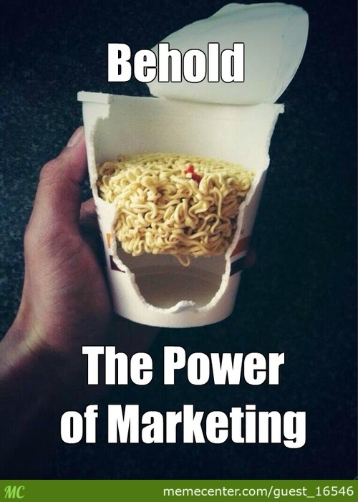

Slide 3
Definition and Importance of Marketing
Definition : Marketing is about identifying and meeting human and social needs. One of the shortest good definitions of marketing is "meeting needs profitably."
The American Marketing Association offers the following formal definition: Marketing is an organizational function and a set of processes for creating, communicating, and delivering value to customers and for managing customer relationships in ways that benefit the organization and its stakeholders.

Slide 4
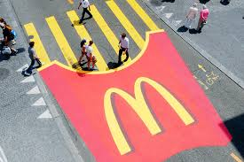

Slide 5
Scope of Marketing
The scope of markeing is very wide. It covers various activities such as :
Study of Consumer Want and Needs
Study of Consumer Behaviour
Product planning and development
Branding
Product design
Implementation of Product
Pricing of product
Packaging
Publicity and promotion of product
Distributuion channel identification and selection
Selling of product
Creating demand for product
Collecting feedback of customers
Providing after sale services
Adapting to latest trends

Slide 6




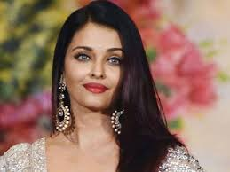





What Is Marketed?
Marketing people market 10 types of Entities : Goods, Services, Events, Experiences, Persons, Places, Properties, Organizations, Information and Ideas.

Slide 7
Needs
Wants
Demands
LEADS TO THE IMPORTANCE OF MARKETING

Slide 8
Importance of Marketing
Competitive Advantage
Customer Satisfaction
Corporate Image
Expansion of Business
Economies of Scale
Increased Efficiency
Attainment of Organisational Objectives
Optimum use of resources
Brand Loyalty
Brand Image
Benefits to Stakeholders
Decision making process (What, When, How)
Helps in Change management and innovations

Slide 9
Importance of Marketing
Consumers
Business Houses
Society
Economy\
Government
Provides them with Choices.
Comparison with different products and services.
Consumer satisfcation.
Fight the competition.
Attract consumers.
Claim market share.
Identify the need of the customer.
Gain knowledge of customer preferences and feedback.
Beneifts from Creating utility.
Research and development.
Generating employment.
Availabilty of Products.
Improving Standard of Living.
Development of the economy.
Large scale production.
Increase in Foreign trade.
Meeting demand with supply.

Slide 10
Functions of Marketing
Market Research
Market planning
Product design and development
Buying and assembling
Product / Service Standardization
Packaging and Labelling
Branding
Pricing
Promotion
Selling and distribution
Warehousing and storage
Transportation
Customer support services

Slide 11

Customer Expectation v/s Customer Delight

